Slide 1

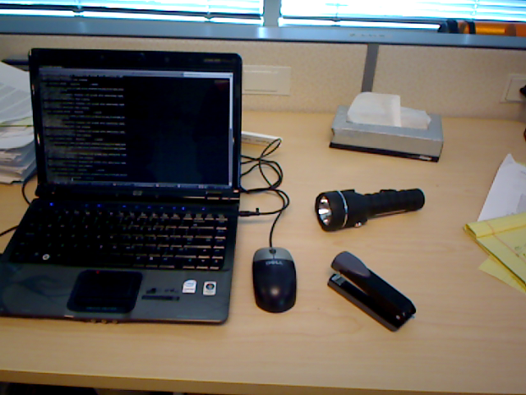
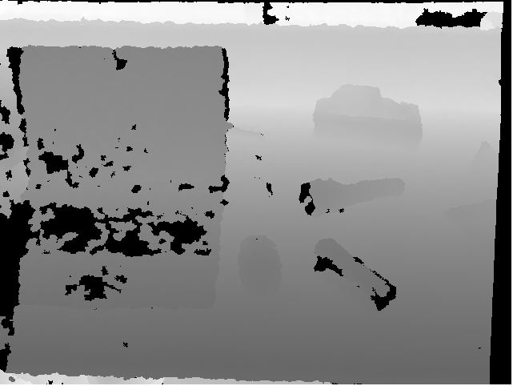
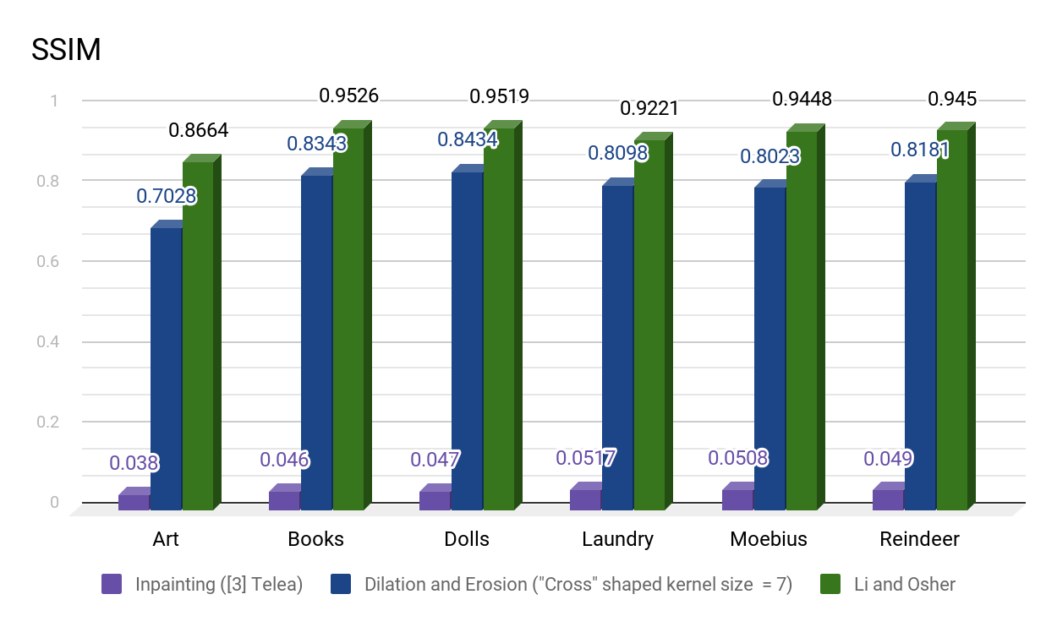
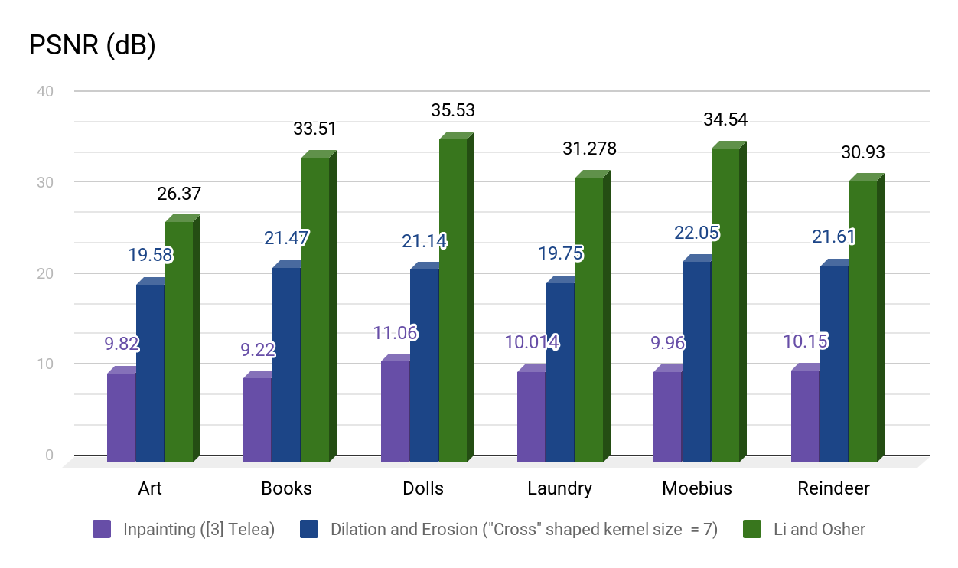
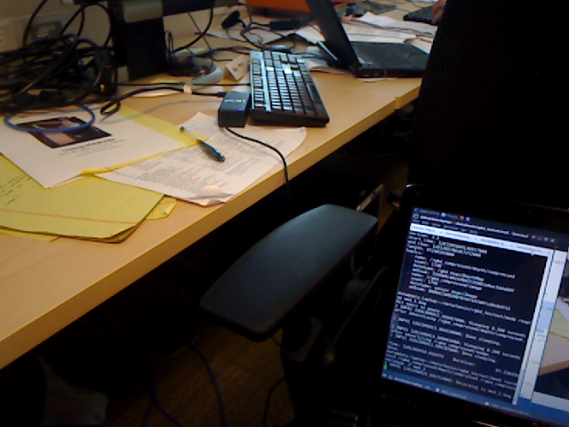
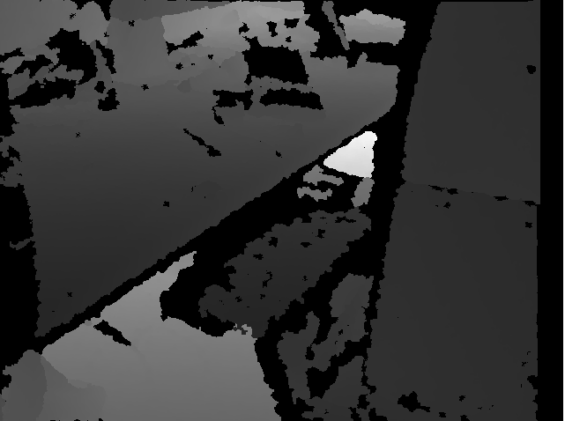
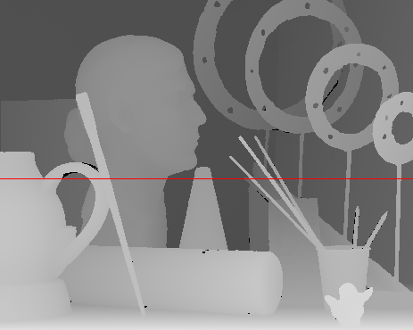
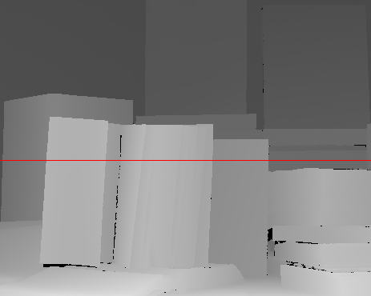
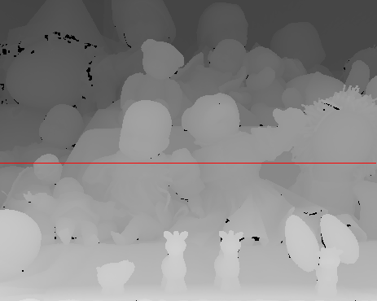
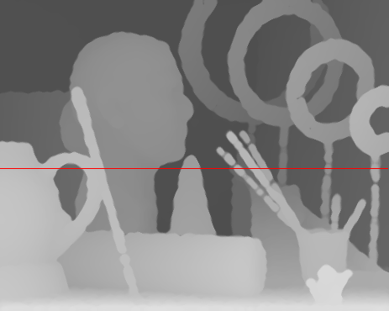
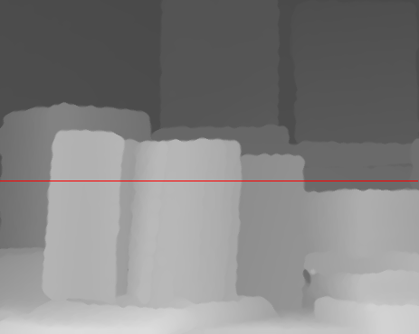
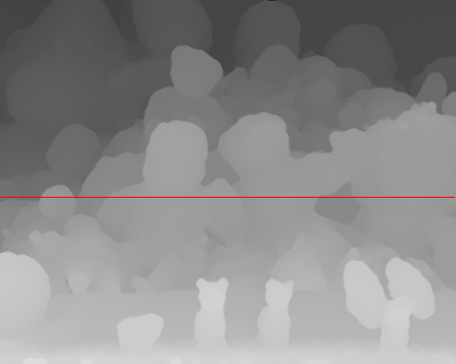
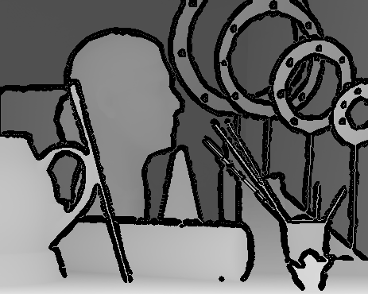
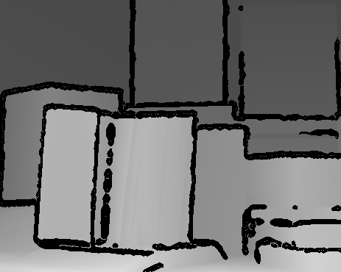
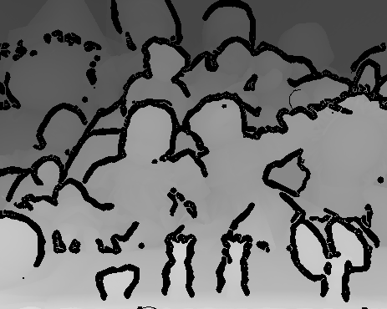
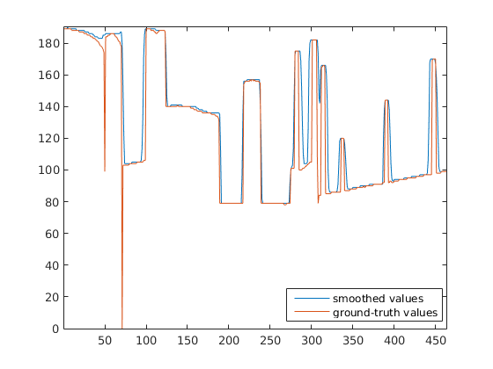
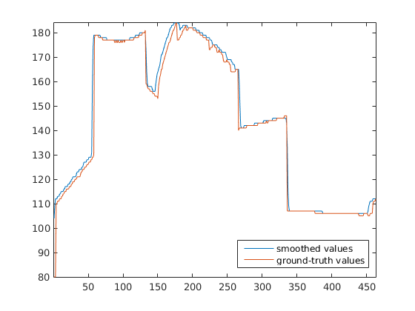
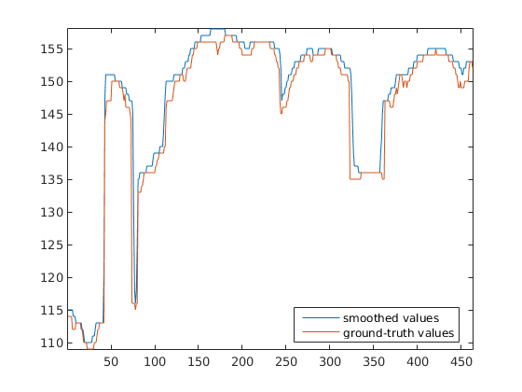
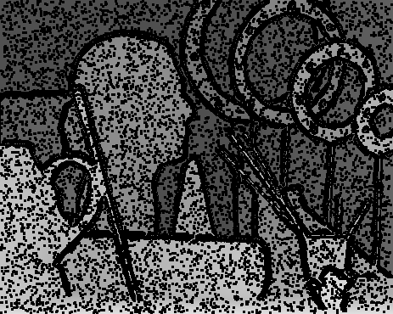
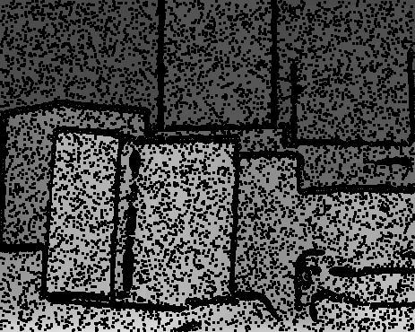
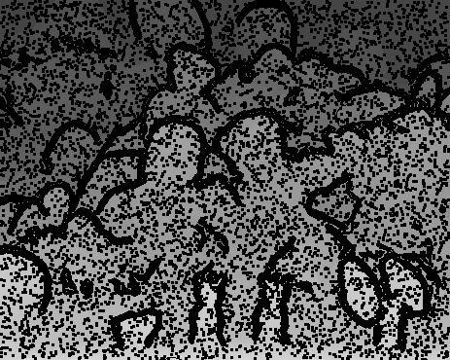
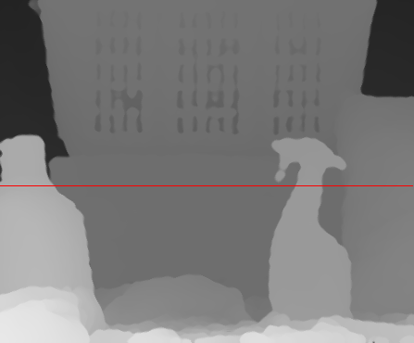
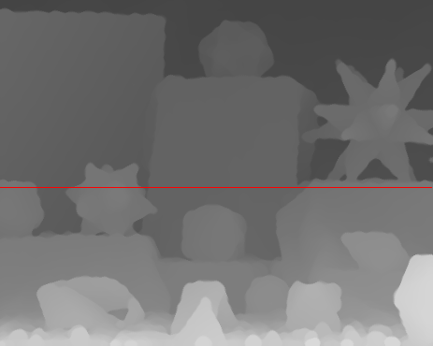
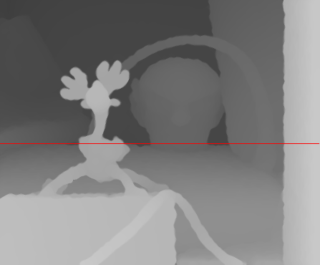
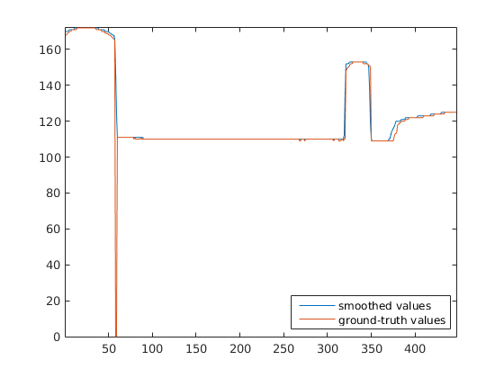
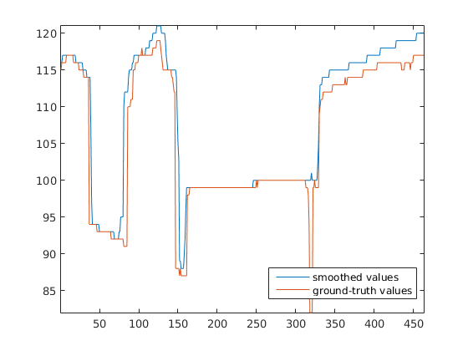
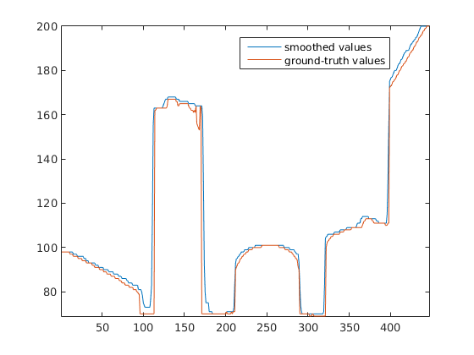
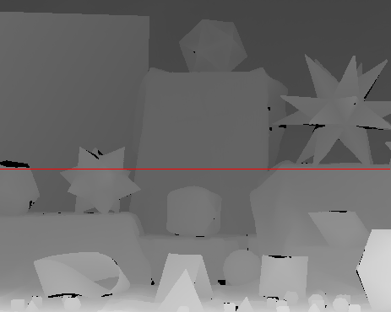
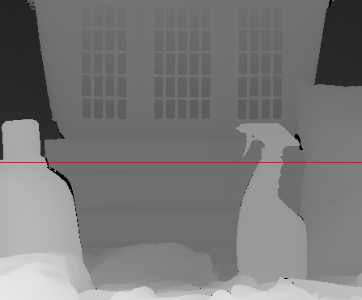
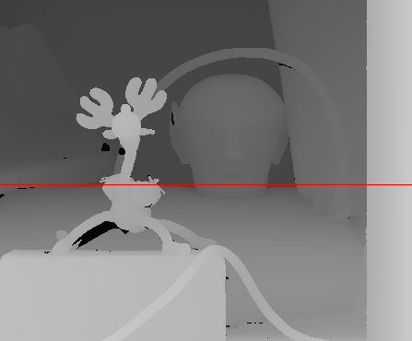
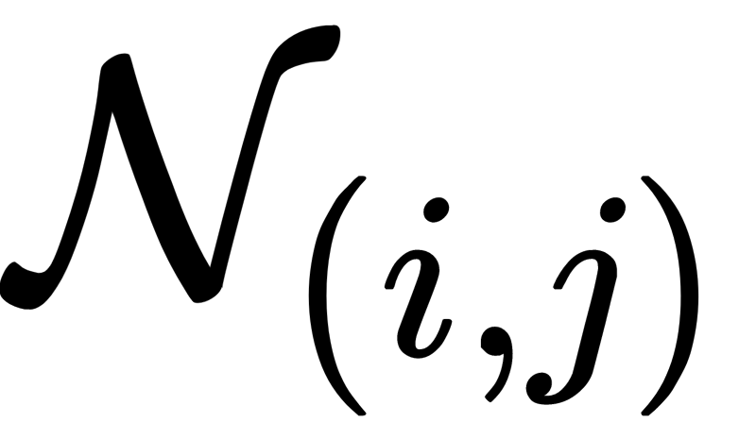
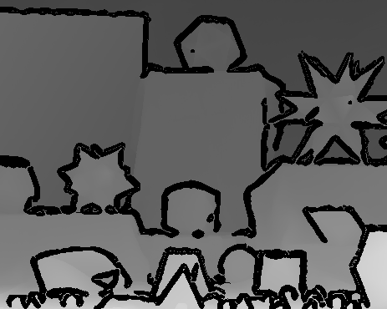
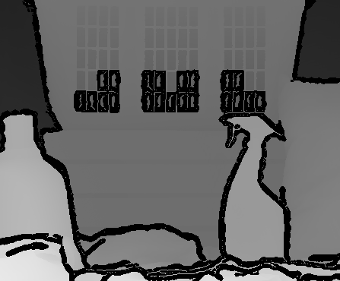
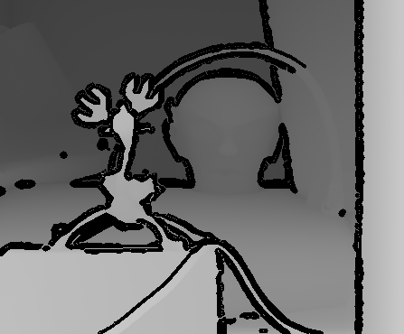
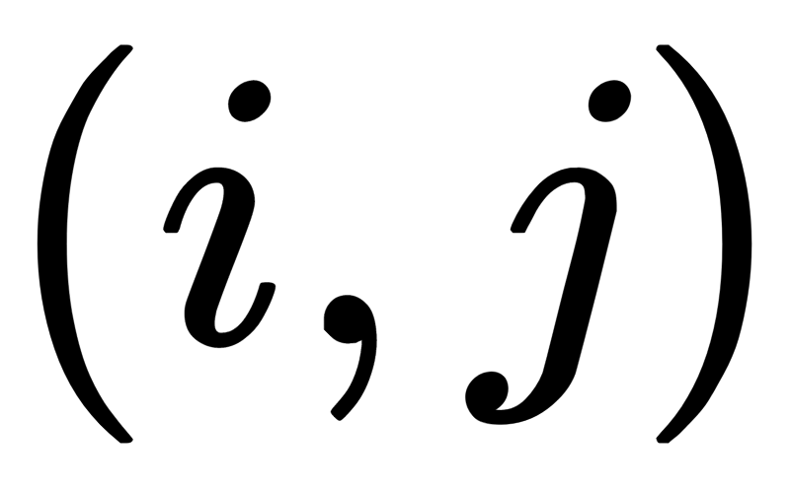
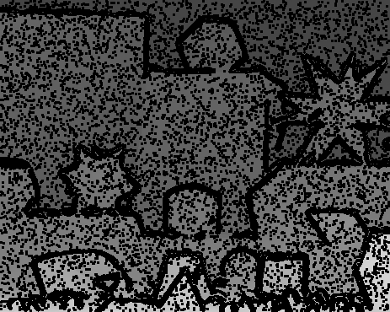
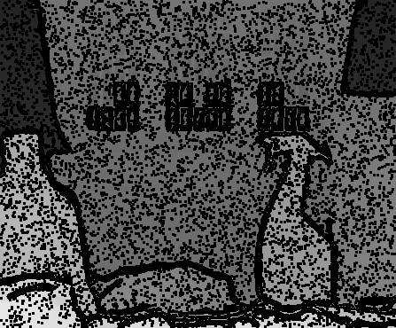
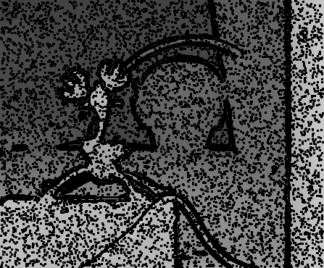
Completion and Denoising of Depth Data from Kinect
Rishab Shah
Motivation
Dataset
Results
Deficiencies of Kinect
Sensor noise.
Structural data missing due to placement of the IR source and the sensor.
Does not work with transparent objects or in the sunlight.
Goal:
Fill-in missing depth data and reduce noise.
Synthetic depth maps for benchmarking.
Kinect deficiencies simulated on ground-truth data from the Middlebury dataset [2] by creating:
Structured missing depth "shadows"
around objects.
Random missing individual depth values.
Denoised depth maps and depth profiles of
ground-truth and estimates along row 200.
Smoothing Algorithm
We estimate smooth depth map û from the input depth map u.
where λ and ξ are weights controlling the degree of smoothing, and is the second-order neighborhood at the pixel .
Direct relationship between the median and L1 minimization as shown by Li and Osher [1]. This simplifies computations.
The discontinuities in the depth map found in the Kinect align with edges in the RGB image. We make ξ small for where the color image has an edge.
References
[1] Hirschmuller, H. and Scharstein, D., 2007, June. Evaluation of cost functions for stereo matching. CVPR'07. IEEE Conference on (pp. 1-8). IEEE.
[2] Li, Y. and Osher, S., 2009. A new median formula with applications to PDE based denoising. Communications in Mathematical Sciences, 7(3), pp.741-753.
[3] Telea, A., 2004. An image inpainting technique based on the fast marching method. Journal of graphics tools, 9(1), pp.23-34.
Acknowledgements
I would like to thank Prof. Konrad and Prof. Tron for their guidance and help.

